Slide 1
Data Centre Project
Autumn Group

Slide 2
Content
1. Overview
2. Work Done
3. Plan
4. References
5. Appendix

Slide 3
Overview – Value Chain Analysis
We have 3 stages in the project
Collect data from different resources (FredOffice, FredPOS, Lots, FredDispense, BestPractice) from 8 pharmacies and 2 clinics
Integrate data into a consistent form (Data warehouse)
The three levels of business analytics
Descriptive analytics – reporting, clustering, tableau reports
Predictive analytics – predictive modelling
Prescriptive analytics – optimization, simulation – recommend decisions

Slide 4
Overview - Predictive Analysis
To build models / equations to predict an unknown outcome, so that the business can count on and make decisions or deal with business issues
Example:
To estimate the cost trend of a particular item bu using regression model
The sales prediction to see how far the OTC growing up

Slide 5
Overview – Data Warehouse
To store historical data over the years
To share sub-datasets to each department
To build a big and enough dataset for forecasting models

Slide 6
Overview – Tableau Server
To centralize Tableau reports
Highly available access
To schedule for generating regular reports

Slide 7
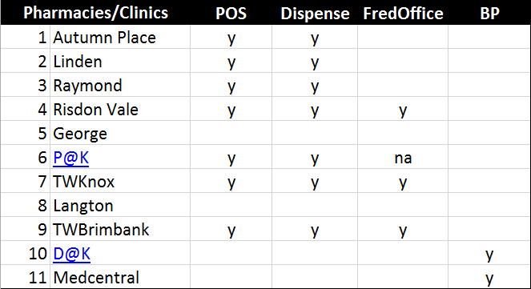
The work done – backup databases
Backup daily for Dispense, POS automatically
Backup weekly for Office
Centralize databases at NAS storage secured
Fg 3: Backup checklist

Slide 8
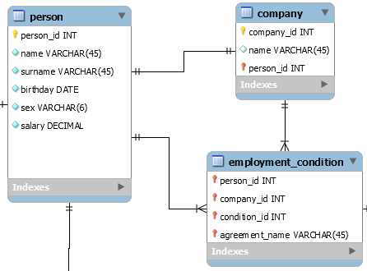
The work done – Entity Relational Diagram (ERD)
The objectives
Understand data
Select important tables
Connect the tables by a relational diagram
The work done
The ERD for Lots
The ERD for Fred POS
ERD Example

Slide 9
References
https://docs.treasuredata.com/articles/tableau
https://www.interworks.com/blog/bfair/2014/08/26/tableau-online-vs-tableau-server-5-things-consider

Slide 10
Appendix
Data collection for Membership
Customer interface at Lots and Fred POS
Zenbership system ^{(*)}

Slide 11
Data Collection for Membership
Lots
Person – customer info
Sales – LayByPersonId
SaleItems – personId
ScriptLink
Fred POS
Customer – customer info
Transaction – customerID, cashierId, scriptNumber,…
TenderEntry – CreditCardNumber, CreditCardExpiration,…
Fred Dispense / POS (*)
Patients
Doctors
Scripts
Best Practice
Appointments
Contact, ContactDetails
Patients
Payments, Services
Visits

Slide 12
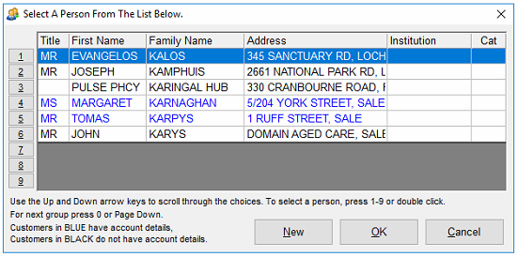
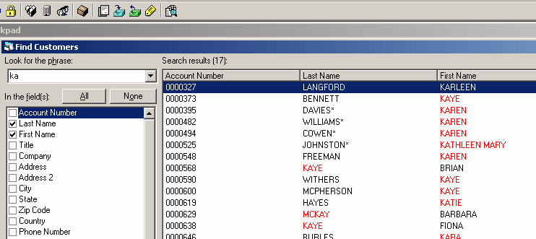
Customer Interface
Customer Interface of Lots
Customer Interface of FredPOS

Slide 13
Zenbership system
An online interface membership management system
Account management
Security management
Mobile notification (sms)
Email marketing
Subscription list
Promotion campaign

